Slide 1

Career Prediction
Using
Machine
Learning

Slide 2

Group Name
CareerCompass
Tuhin Patra
Pankaj Sadhukhan

Slide 3
Project Description
Spearheading personal and national development, providing individuals with the right career guidance is crucial in a rapidly evolving world.
This project aims to leverage the power of machine learning (ML) to provide accurate career predictions tailored to individual strengths, interests, and market demands.
By analyzing relevant data points such as academic performance, skills, interests, the ML model will offer personalized career recommendations to students, especially those in rural areas who lack access to traditional counseling services.

Slide 4


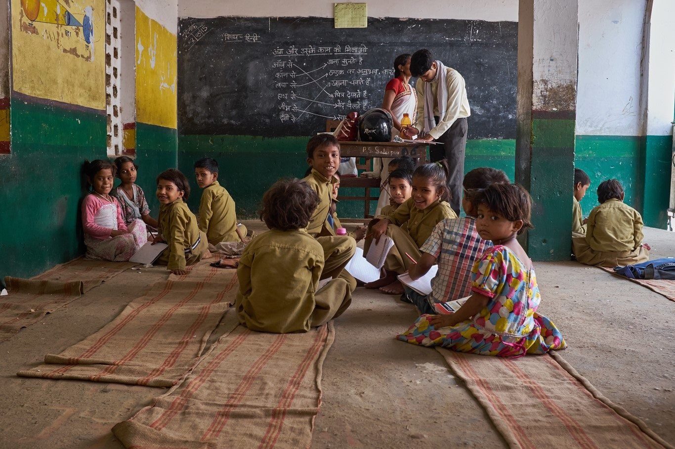
Motivation Towards This Project
Children's Potential Power:
Awareness of Study Fields:
Importance of Proper Guidance:
Every child in India is a valuable asset, with the potential to contribute significantly to the country's growth across various sectors.
Students in rural areas may lack awareness of emerging study fields and career opportunities. Without proper guidance, they may struggle to align their skills and interests with the demands of modern industries
Before a country can develop fully, it must ensure that its children receive adequate guidance. Proper counselling is crucial in helping students determine the most suitable career paths.

Slide 5
Methods to apply
To solve this problem here we will use some machine learning algorithm such as:
KNN
Naïve Bayes
Decision Tree
Support Vector Machine
Random Forest

Slide 6
Timeline
Work Division
Work | Name
Literature Survey | Pankaj &Tuhin
Data Gathering | Tuhin
Data preprocessing | Pankaj
Training & Testing | Pankaj & Tuhin
Parameter Tuning | Tuhin
Make Prediction | Pankaj & Tuhin
Data Gathering
Training &
Testing
Make Prediction
05/03-13/03
23/03-12/04
24/04-01/05
Data Preprocessing
Parameter Tuning
Literature survey
14/03-22/03
13/04-23/04
23/02-04/03

Slide 7
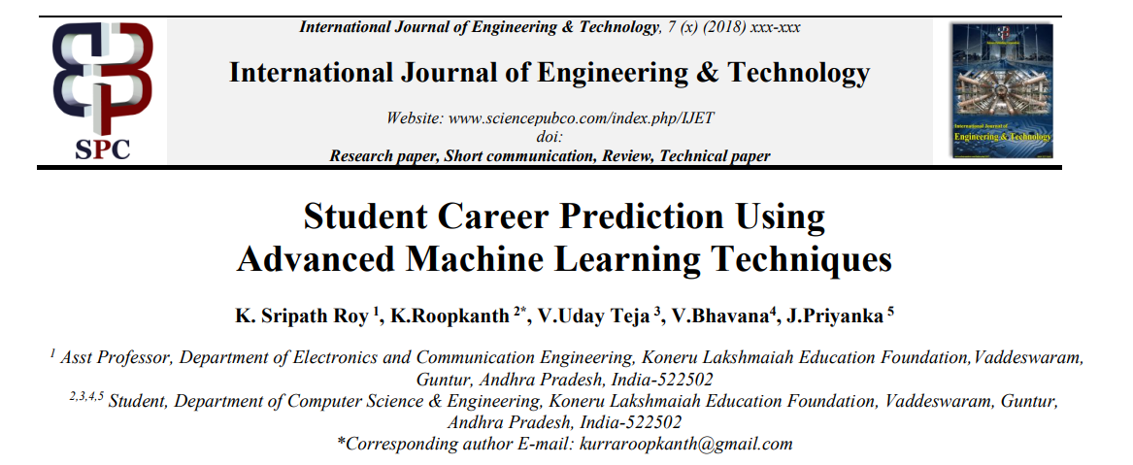
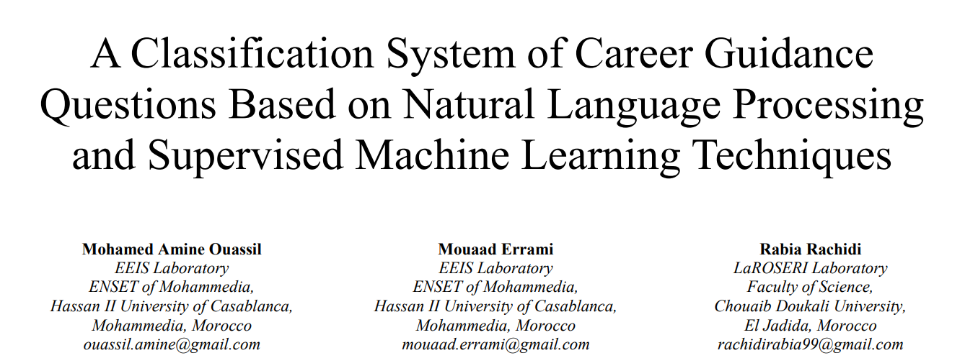
Literature Survey
Paper referenceLink: https://ieeexplore.ieee.org/stamp/stamp.jsp?tp=&arnumber=10152874&isnumber=10152873

Slide 8
Literature Survey
Paper Name: Career Prediction System by V Madhan Mohan Reddy
Published on: International Journal of Scientific Research in Science and Technology
Used Methodology: 1. XG Boost
2.Decision Tree
Paper Name: Prediction Of Undergraduate Students’ Career Using Various Machine Learning And Ensemble Learning Algorithms
Published on: Webology
Used Methodology: 1.Gradient boosting(62%)
2.Voting Classifier(82.75%)
Paper Name: Career Prediction Classifiers based on Academic Performance and Skills using Machine Learning by Akanksha Pandey, , L S Maurya
Published on: SSRG International Journal of Computer Science and Engineering
Used Methodology: 1.KNN(63%)
2. Stochastic Gradient Descent(62%)

Slide 9
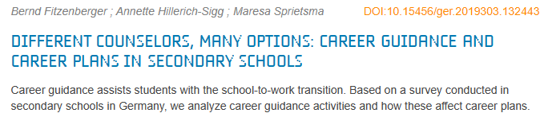
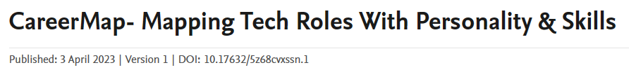
Data Gathering

Slide 10
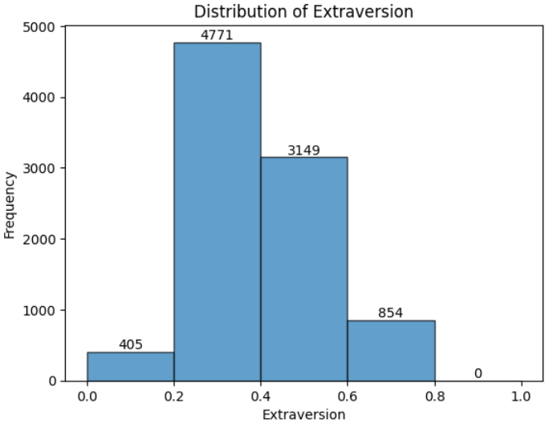
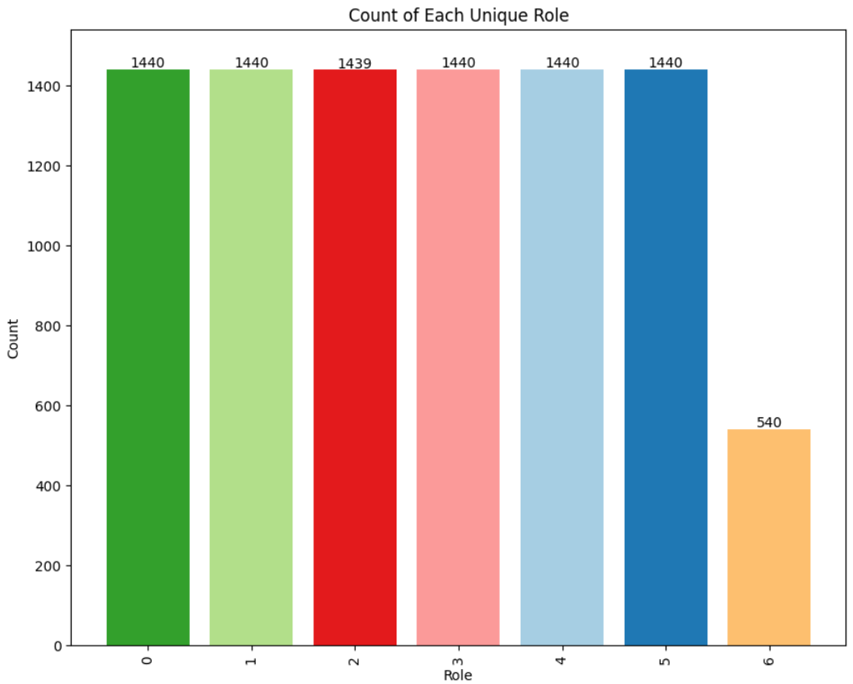
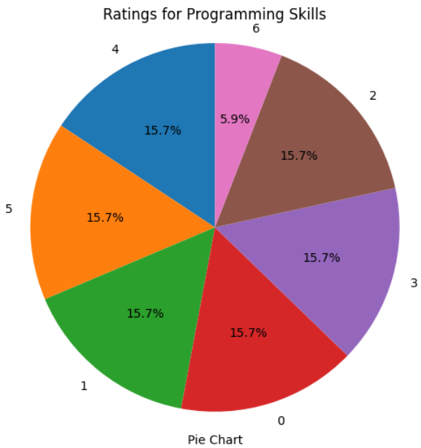
Data Pre-Processing
We have done Data preprocessing on our dataset.
It ensures that the data is
Accurate
Consistent
Here is our Datasource link: \CareerPrediction.csv
https://data.mendeley.com/datasets/5z68cvxssn/1
Our data has 9179 samples and 28 columns.
2
1
3

Slide 11
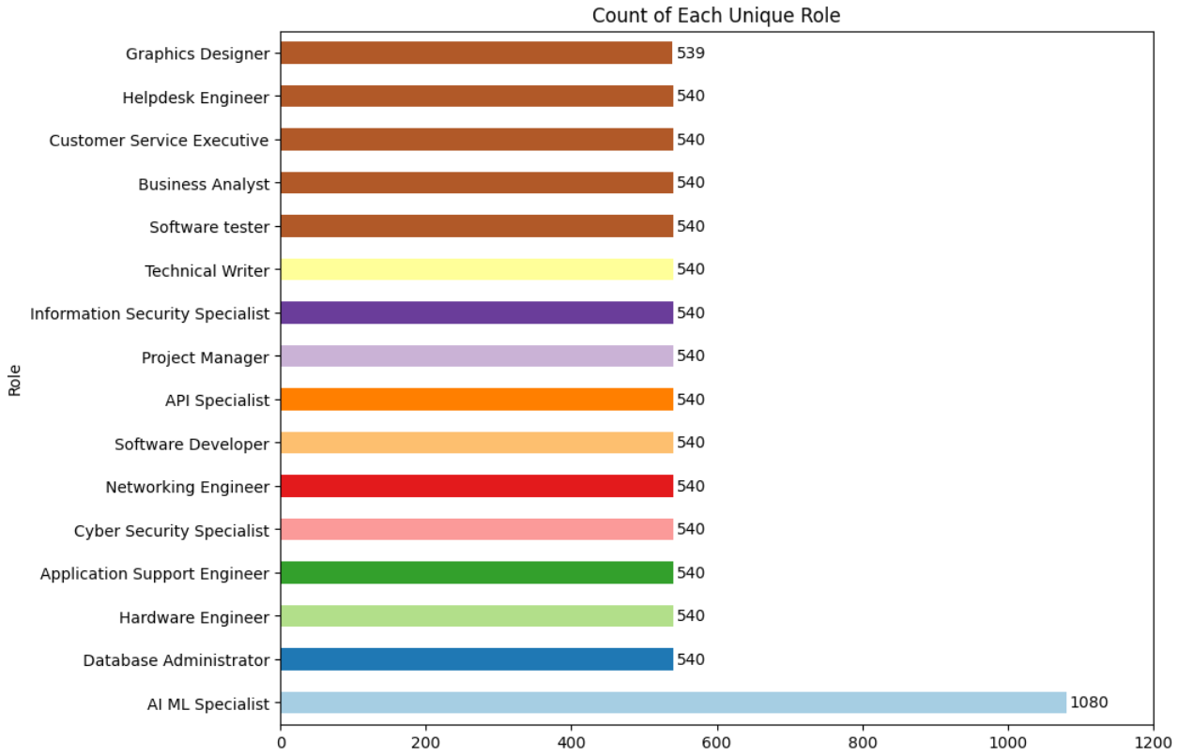
For each unique roll how many data are there in the dataset

Slide 12
Ratings of Programming skills(Ratings are given b/w 0 to 6)

Slide 13
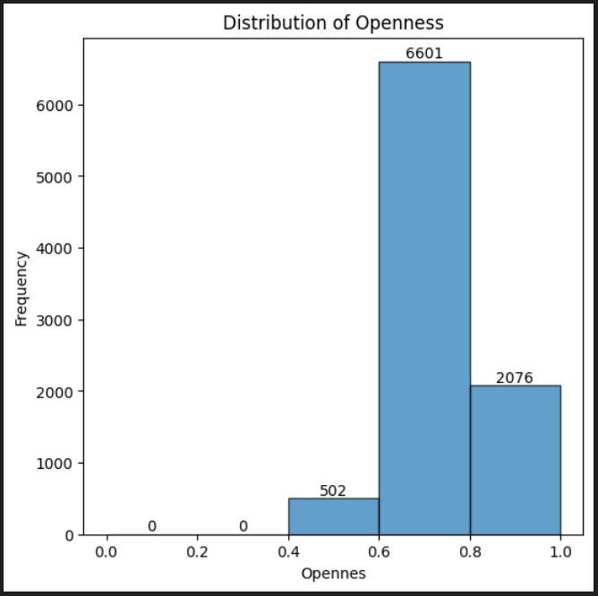
Distribution of Openness
Conclusion: Majority votes between 0.6 to 1, means most people are very much open in nature

Slide 14
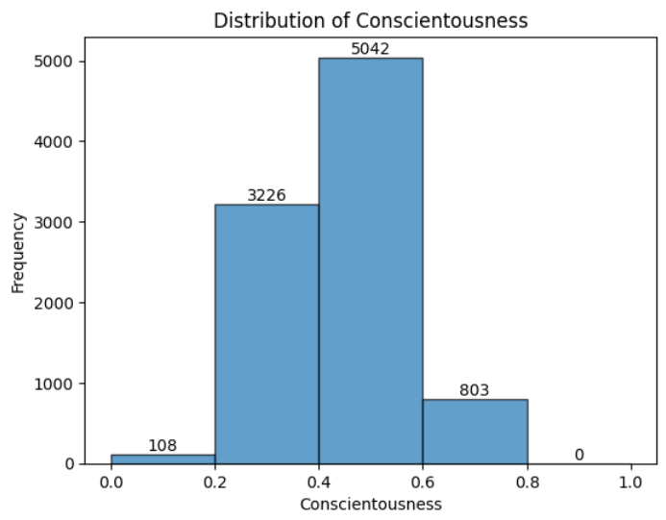
Ratings of Conscientiousness
Conclusion: Most people voted between 0.4 to 0.6 about his conscientousness

Slide 15
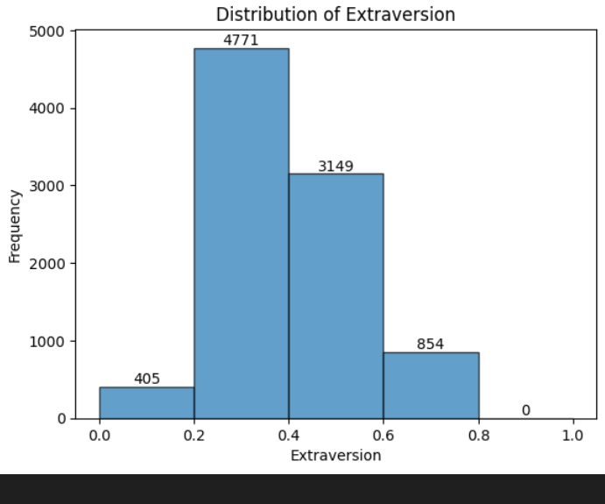
Ratings of Extraversion
Conclusion: Most people voted for 0.2 to 0.6

Slide 16
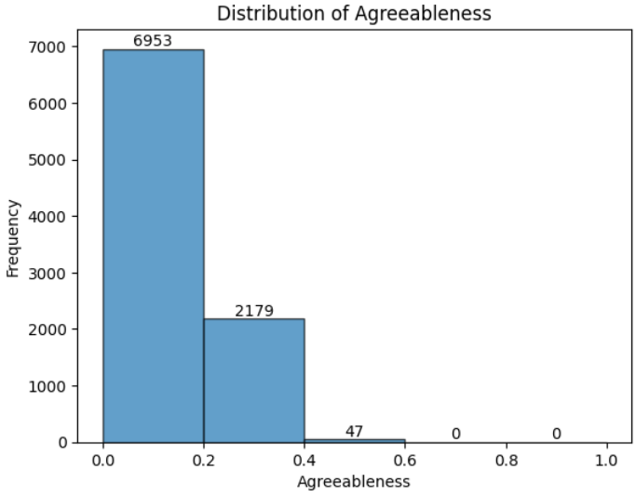
Ratings of Agreeableness

Slide 17
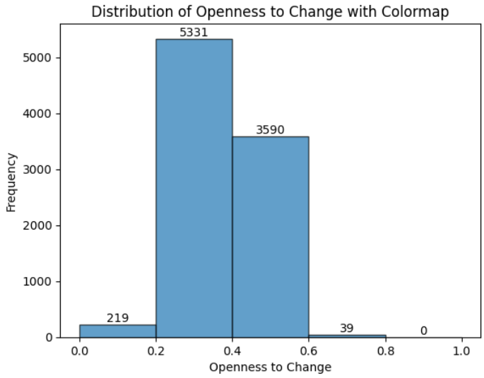
Ratings of Openness to change
Conclusion: Most people are not very much open to change his job

Slide 18
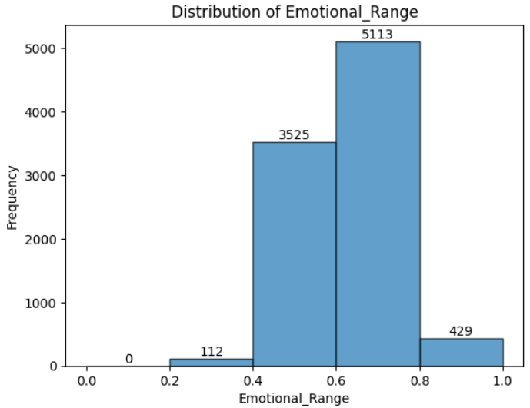
Ratings of Emotional_Range
Conclusion: From plot we can conclude that most people are moderately flexible about his emotional condition

Slide 19
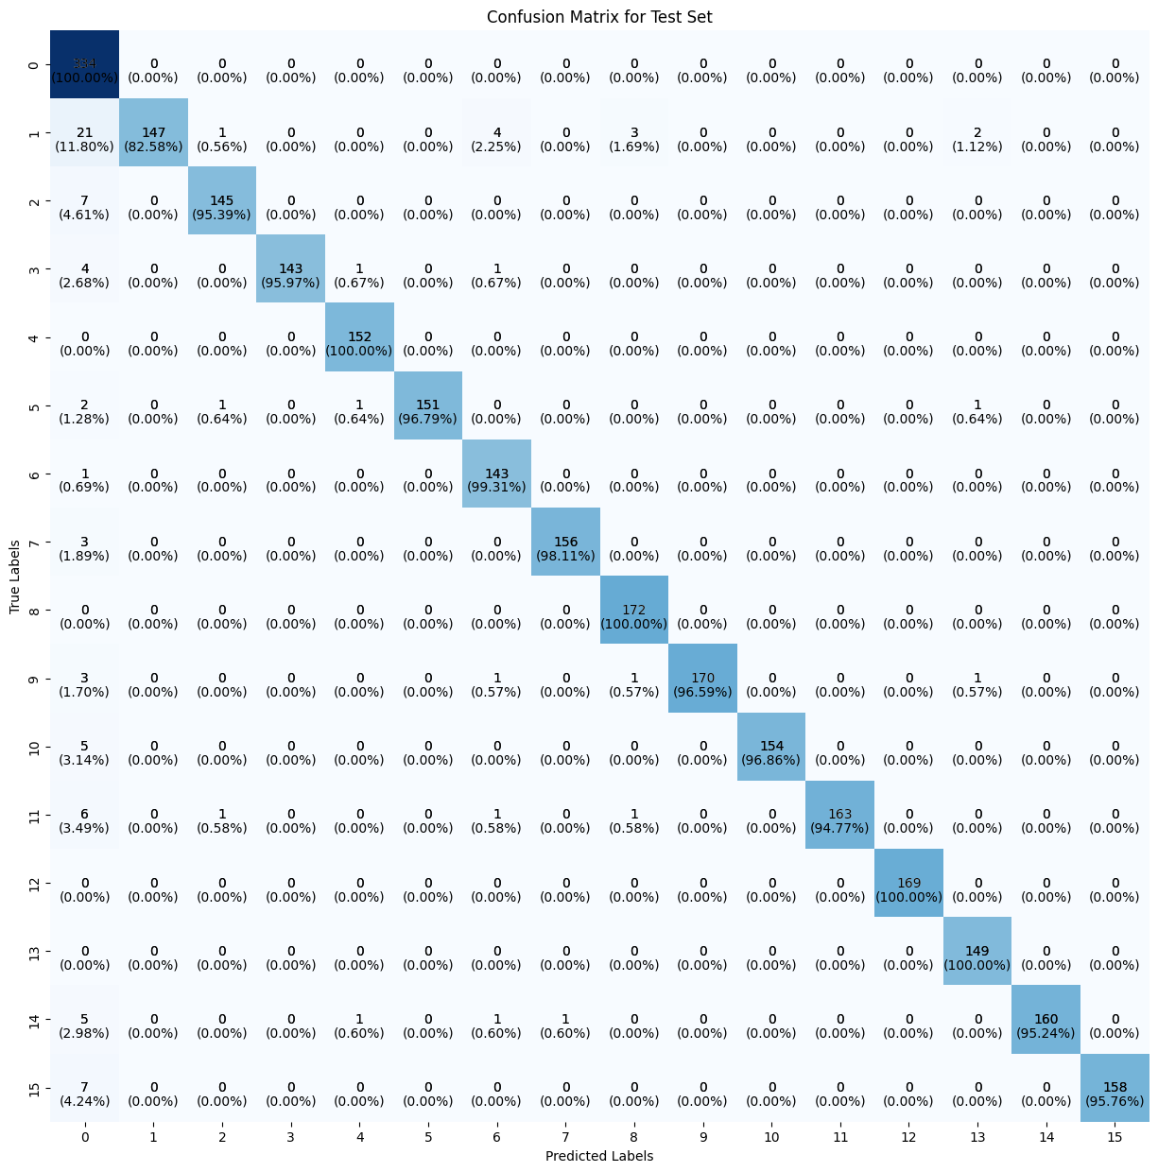
Model Training
KNN : We have trained our model with KNN classifier. For K=95 it is giving the best result. Train accuracy is 98% and test accuracy is 97%.
We have also calculated the confusion matrix for the test set.

Slide 20
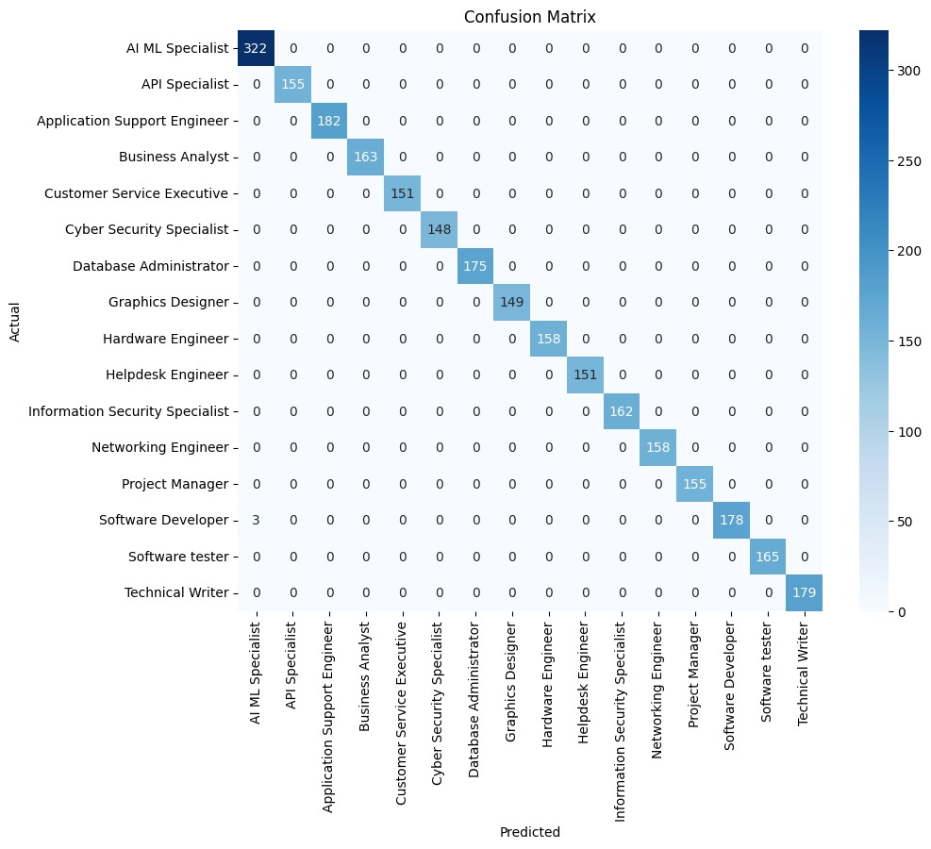
Model Training
Naïve Bayes : We have trained our model with Naïve Bayes classifier. For Gaussian Naïve Bayes it is giving the best result. Train accuracy is 100% and test accuracy is 99.8%.
We have also calculated the confusion matrix for the test set.

Slide 21
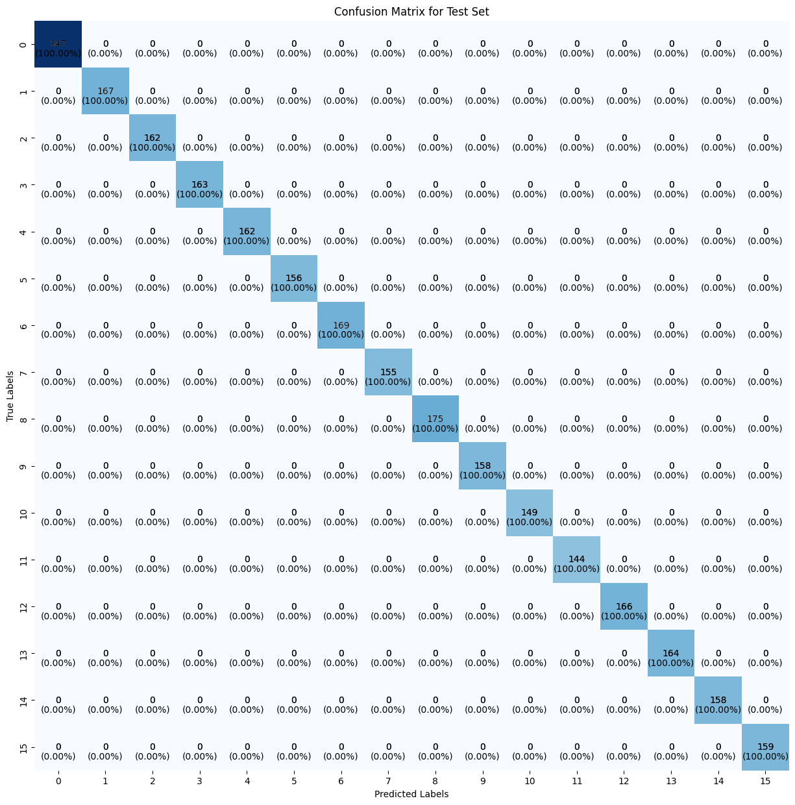
Model Training
Decision Tree : We have trained our model with Decision Tree classifier. For maximum depth 15 it is giving 100% accuracy for both train and test set. We have also calculated the confusion matrix for the test set.

Slide 22
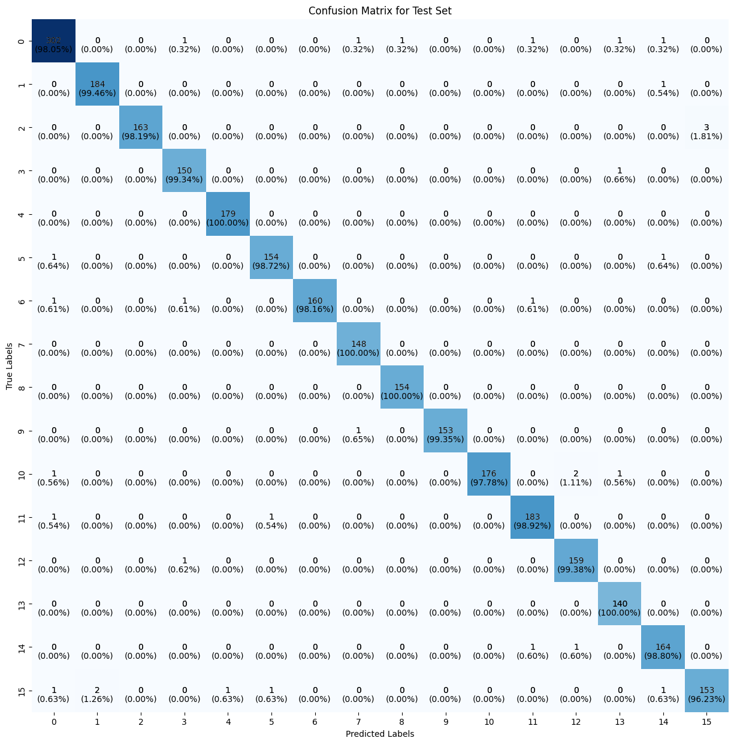
Model Training
SVM : We have trained our model with SVM classifier. For RBF kernel and C=1.0 it is giving best result. For train set, accuracy is 99% and test accuracy is 98%.We have also calculated the confusion matrix for the test set.

Slide 23
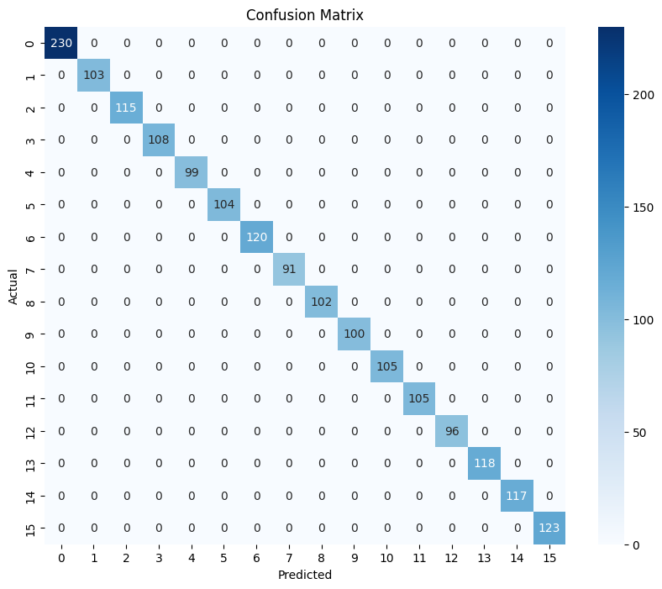
Model Training
Random Forest : We have trained our model with SVM classifier. For n_estimators = 100,max_depth = None,min_samples_split=2,
main_samples_leaf = 1 it giving best result. Train and test both accuracy is 100%.We have also calculated the confusion matrix for the test set.

Slide 24
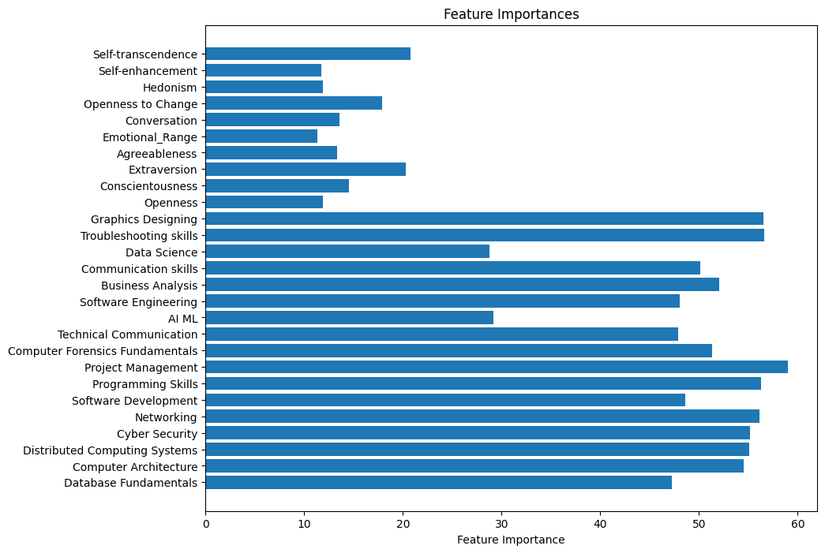
Model Training
Random Forest : Feature Importance for random forest model is

Slide 25
Summary Table
Model Name | Hyper Parameters | Train accuracy | Test Accuracy
KNN | K=95 | 98% | 97%
Naïve Bayes | Gaussian Naive Bayes | 100% | 99.8%
Decision tree | Maximum Depth=15 | 100% | 100%
SVM | RBF kernel, C=1.0 | 99% | 98%
Random Forest | n_estimators=100 max_depth=None min_samples_split=2 main_samples_leaf = 1 | 100% | 100%

Slide 26
After Dropping some columns

Slide 27
Model Training
Getting 100% accuracy, we have reduce some column from data.
Students who are still in school level, those students does not have any idea about AI ML or Software Development. So we have drop this type of column from our dataset.
Selected Columns : 'Computer Architecture', 'Programming Skills', 'Project Management', 'Communication skills', 'Openness', 'Conscientousness', 'Extraversion', 'Agreeableness', 'Emotional Range', 'Conversation', 'Openness to Change', 'Hedonism', 'Self-enhancement', 'Self-transcendence'
After that we have implemented machine learning model on our revised data. Then we have done hyperparameter tuning and inspect the test accuracy.

Slide 28
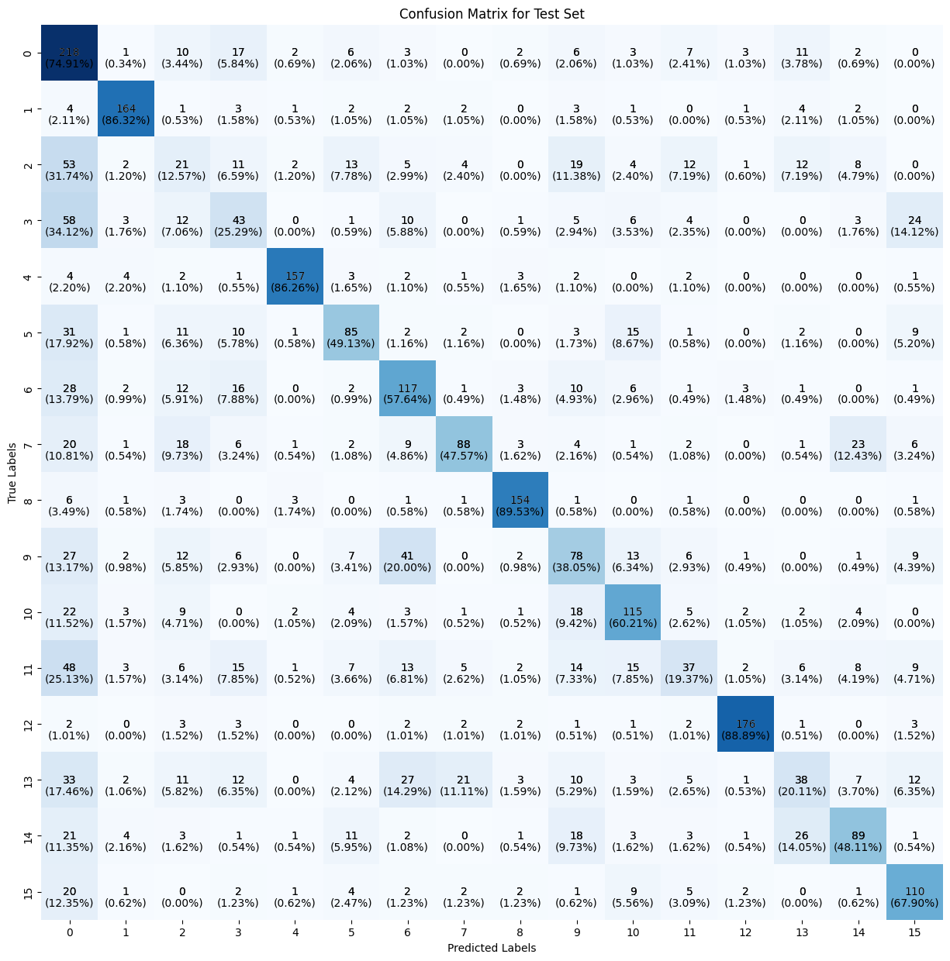
Model Training
KNN : We have trained our model with KNN classifier. For K=95 it is giving the best result. Train accuracy is 65% and test accuracy is 55%.
We have also calculated the confusion matrix for the test set.

Slide 29
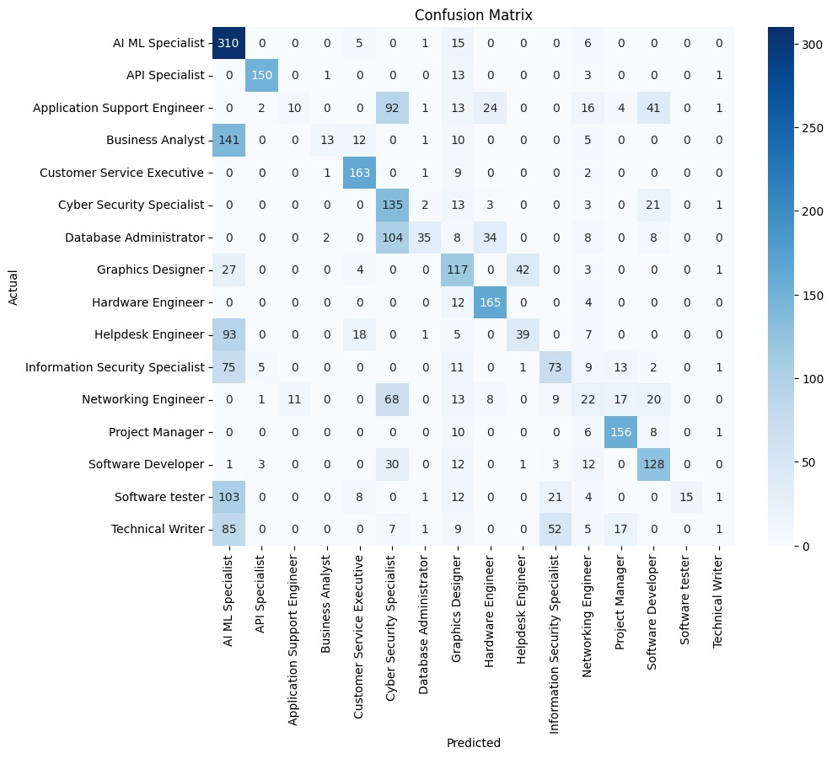
Model Training
Naïve Bayes : We have trained our model with Naïve Bayes classifier. For Gaussian Naïve Bayes it is giving the best result. Train accuracy is 51.1% and test accuracy is 50.16%.
We have also calculated the confusion matrix for the test set.

Slide 30
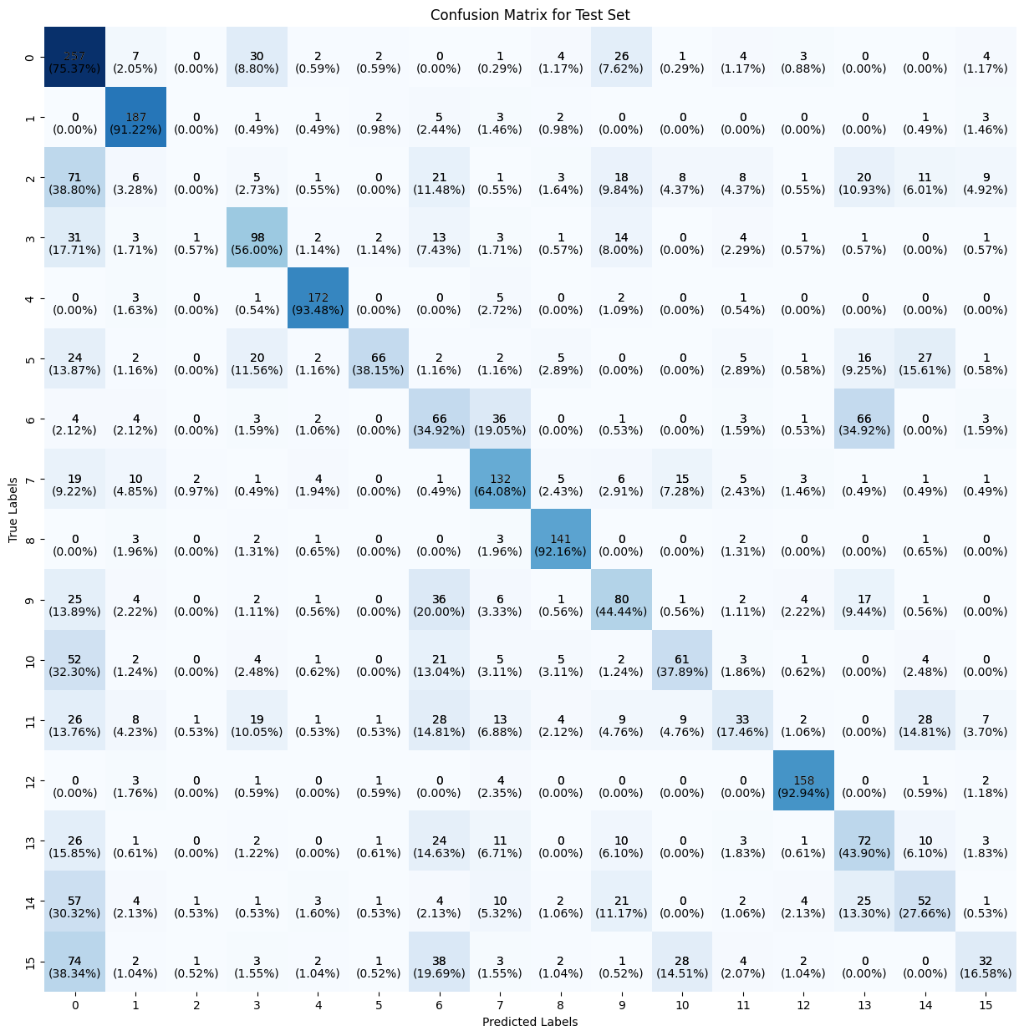
Model Training
SVM : We have trained our model with SVM classifier. For linear kernel and C=7.0 it is giving best result. For train set, accuracy is 55% and test accuracy is 52%.We have also calculated the confusion matrix for the test set.

Slide 31

Model Training
Random Forest : We have trained our model with SVM classifier. For n_estimators = 200,
max_features=14,min_samples_split=8,
main_samples_leaf = 7 it giving best result. Train accuracy is 97% and test accuracy is 89%.We have also calculated the confusion matrix for the test set.

Slide 32
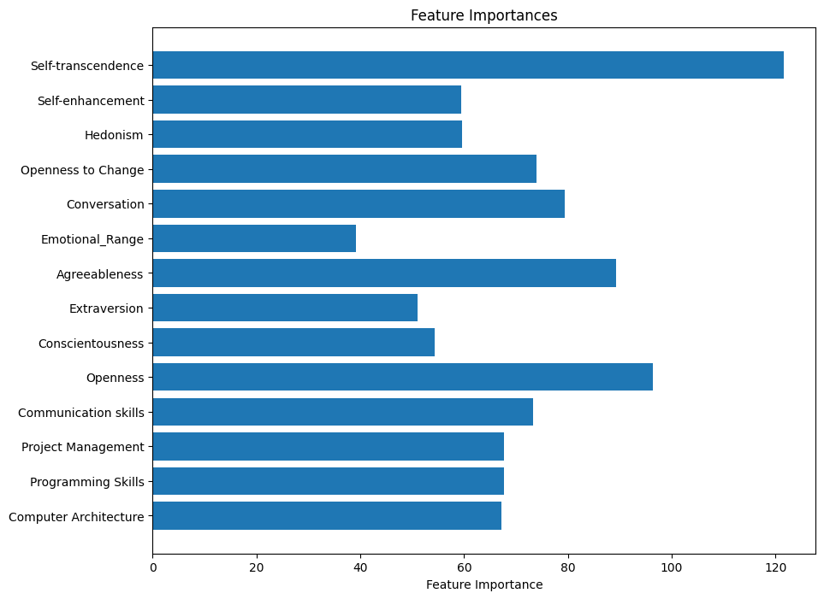
Model Training
Random Forest : Feature Importance for random forest model is

Slide 33
Summary Table
Model Name | Hyper Parameters | Train accuracy | Test Accuracy
KNN | K=10 | 65% | 55%
Naïve Bayes | Gaussian Naïve bayes | 51.1% | 50.16%
SVM | Linear kernel, C=7.0 | 55% | 52%
Random Forest | n_estimators=200 max_features=14 min_samples_split=8 main_samples_leaf = 7 | 97% | 89%

Slide 34
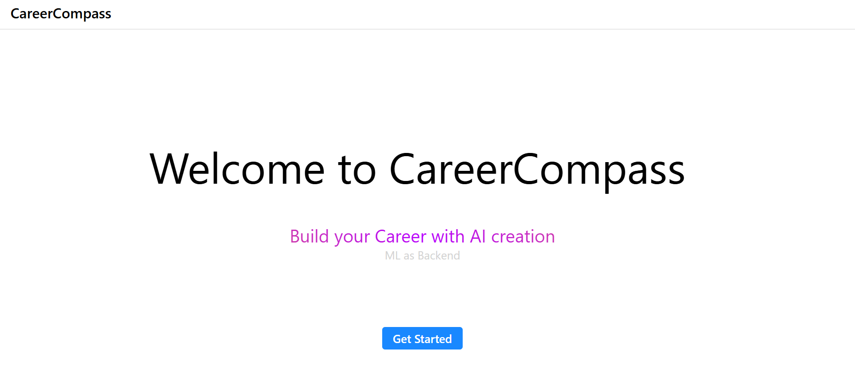
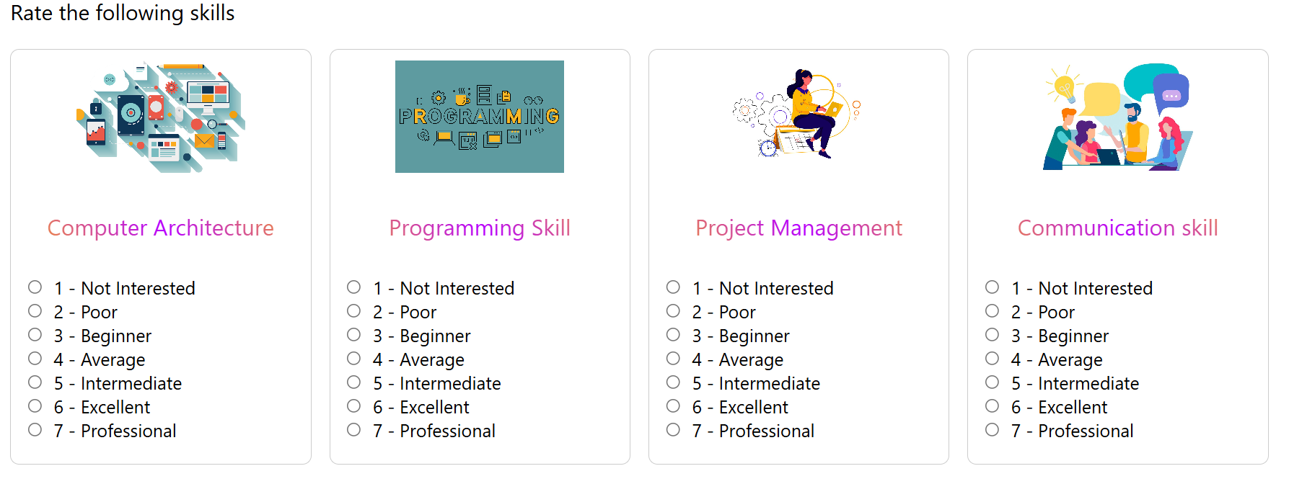
Web Application

Slide 35
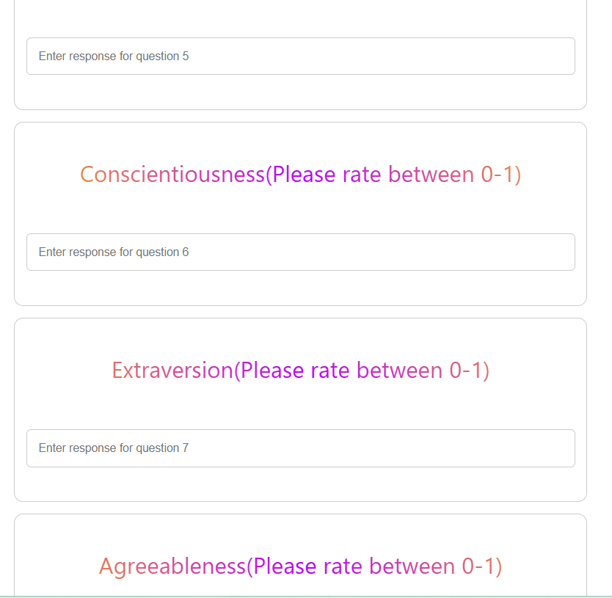
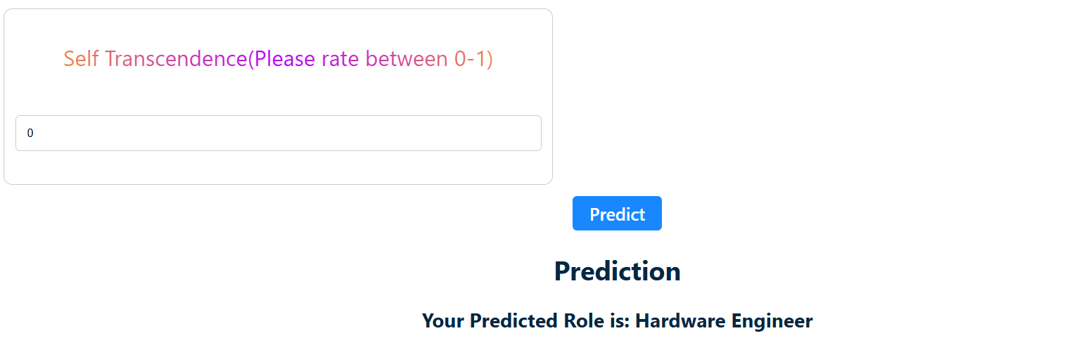
Web Application

Slide 36
Thank You

